Slide 1
Quality Management since 1983
Process Control and Analytics since 1983

Slide 2
PDAP Overview CAQ-Modules and Extensions
Management View - On-click, One-page Overviews and Analysis
(Browser Based)
PDAP MV
WEB SERVICE
PDAP-Analytics – Interactive Reporting
(Browser Based + Client Based)
PDAP BI
OFFICE
PDAP-Operational CAQ System
(PDAP-Client Installation)
SPC
GOODS INCOME
OUTGOING GOODS
COMPLAINT PROCESS
…
BI / MV
ERP / PDAP / Audit
Machine Middleware

Slide 3
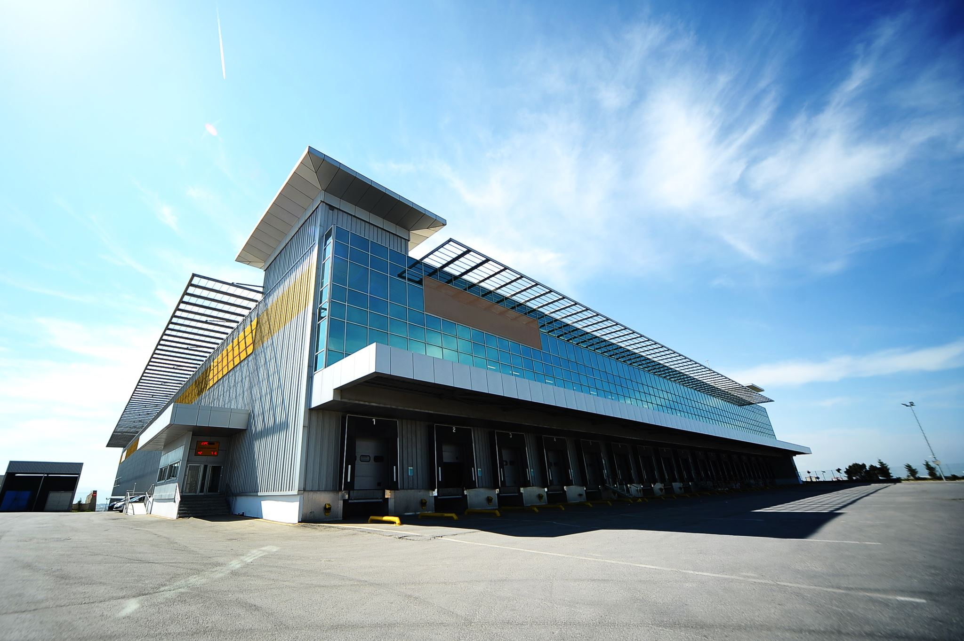
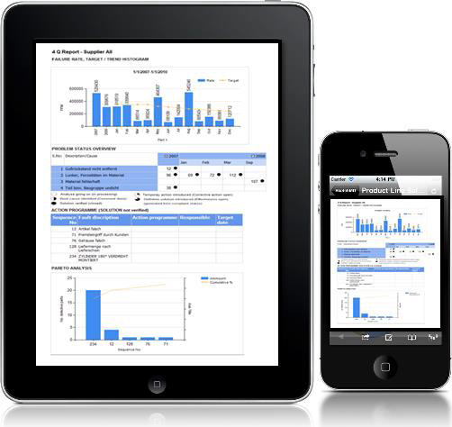
PDAP System Overview
The Timing Of Feedback-Information Is As Important As The Content
User Management
Role Management
Reminder and To Do Lists
Q-Link – Hyperlink Service to invoke Modules by third party tools and websites

Slide 4
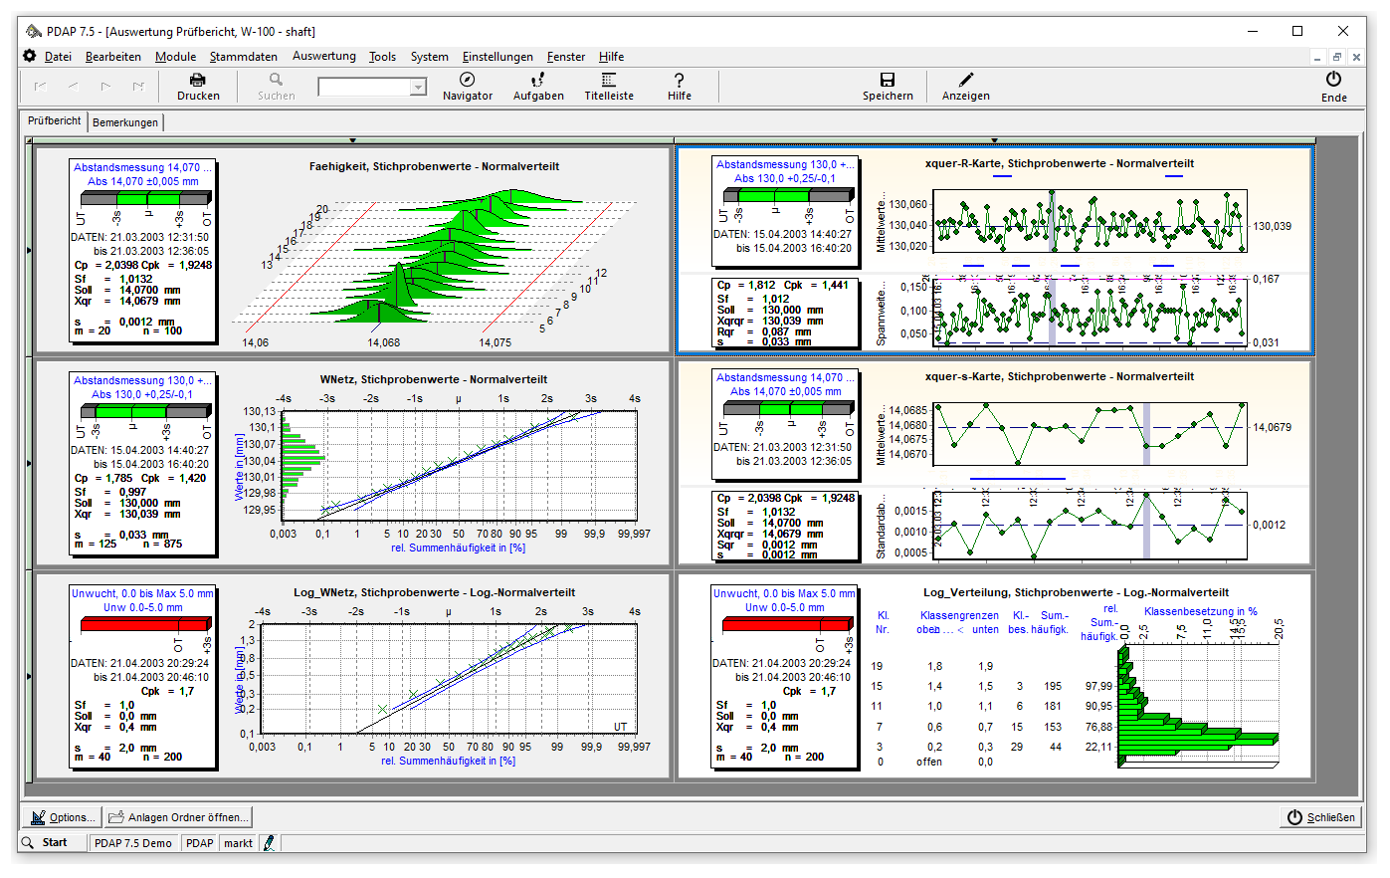
Modules for process monitoring and operational CAQ
Goods income inspection
Statistical Process Control
attribute chart analysis
process control cards
inspection reporting
Outgoing goods inspection
Complaint management
8D-Reporting
Activity Management

Slide 5
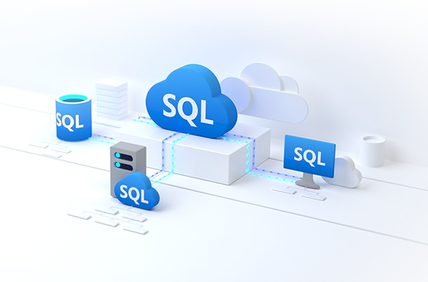
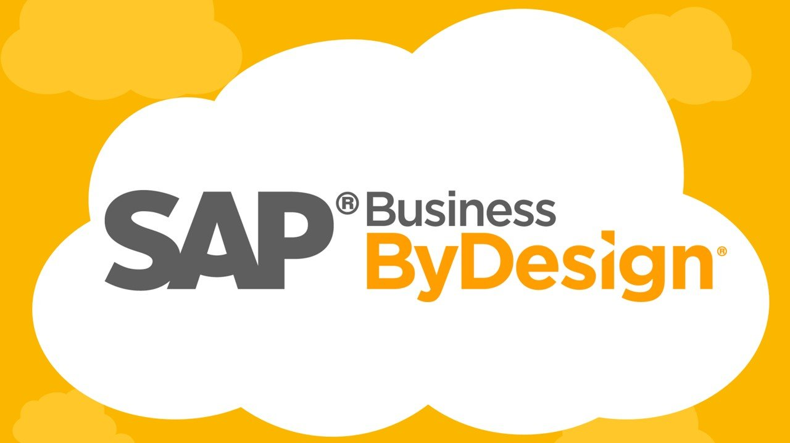
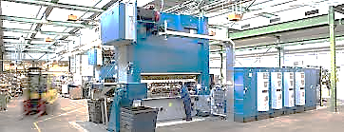
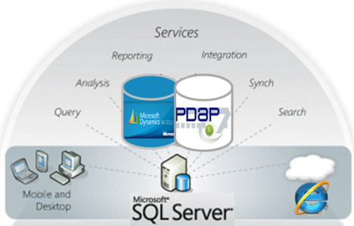
PDAP Interfaces Overview
CAQ Scenarios With Extensive Interfaces
Data Acquisition And Consolidation According To The ETL Principle:
Internal And External Databases Machine Data Acquisitionin Employees / Customers / Suppliers
Different Sources And Different Qualitys
Different Formates
Connectors to ERP Systems
Connection to production environment for SPC
Connectors for inspection environment
Customized connections to other services and data sources as needed
Office Integration: Interfaces for Word and Excel for data and document exchange
Webservice File TCP Network Share
<XML /> JSON CSV IDOC OGP XLSX DOCX SQL
APQP

Slide 6
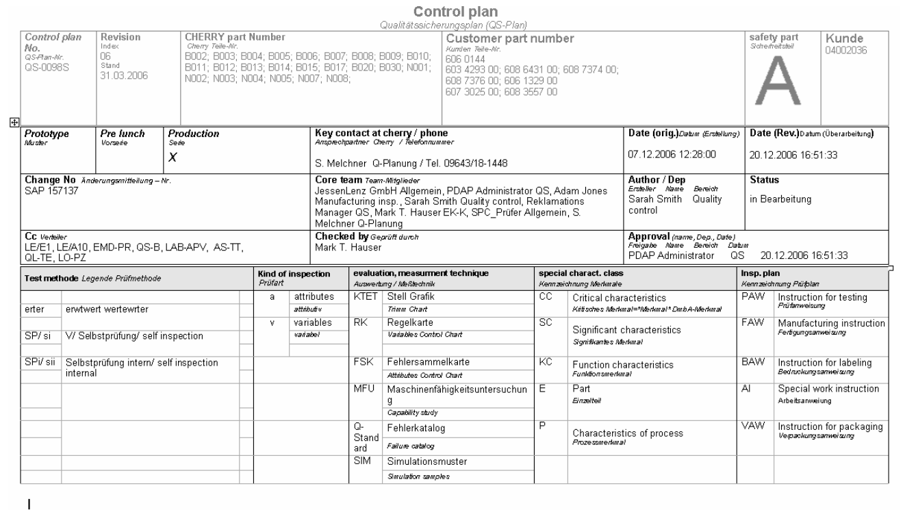
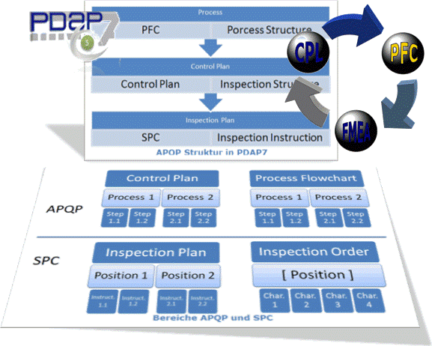
Quality Planing and strategical CAQ
APQP
Risk Matrix
FMEA
Control Plan
First Sampling
Inspection Planing

Slide 7
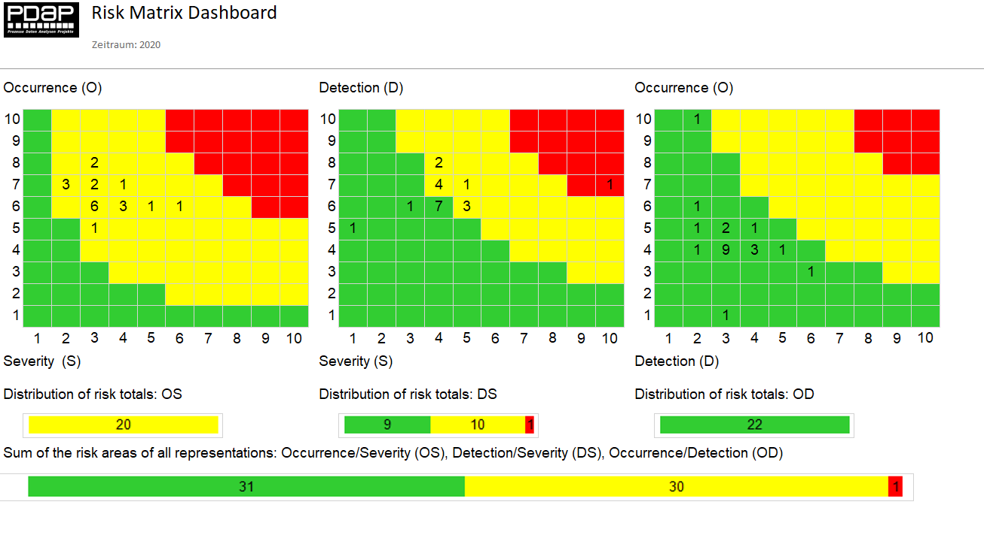
Risk Management Matrix
Simple browser based interfaces
Analysis over all connected systems
One Page Views
KPI-Boards and Score Cards
Management Reviews
Office like designer
Process risk assessment
Plausibility Feedback Evaluation for FMEA

Slide 8
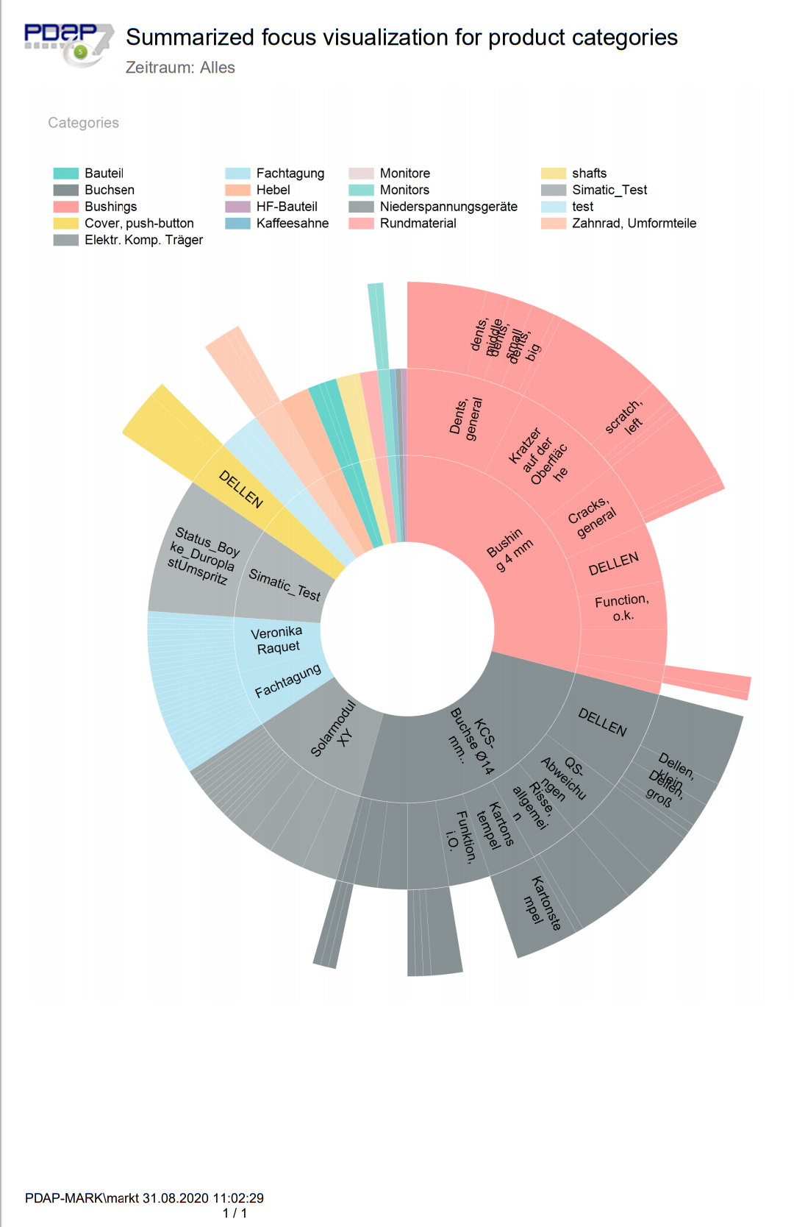
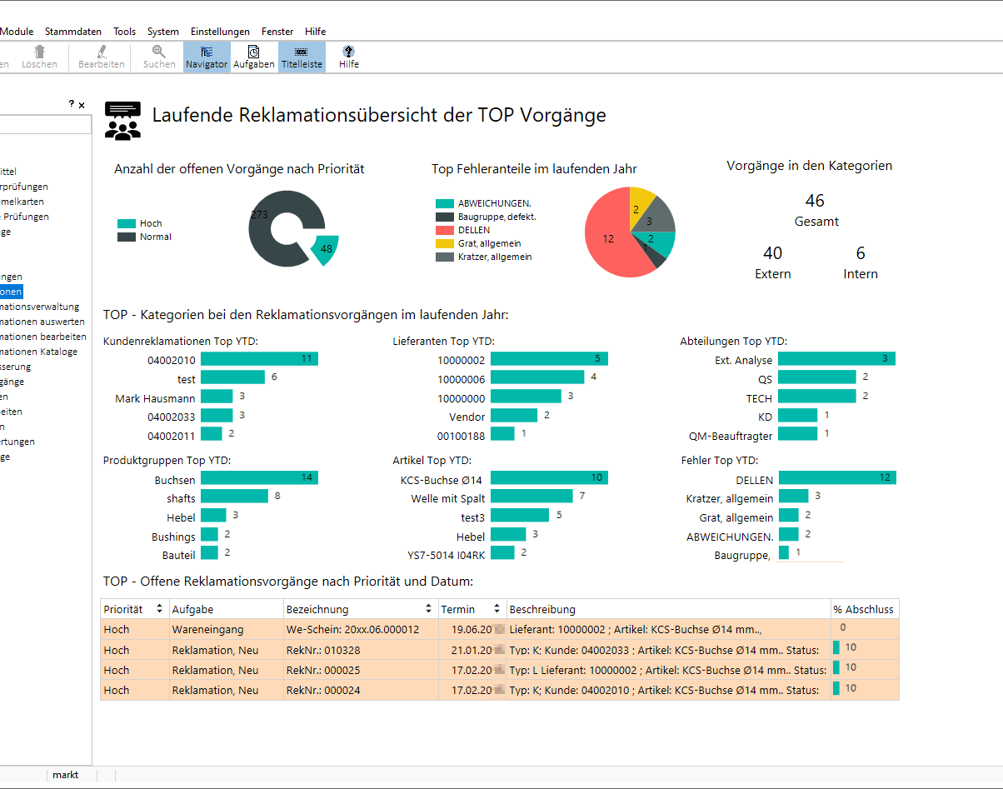
Enterprise Reporting Plattform Profiding Central Dashboards
Ongoing Overviews
Monitoring of Target Values
Summarized Sunburts Charts
TO DO List of open actions

Slide 9
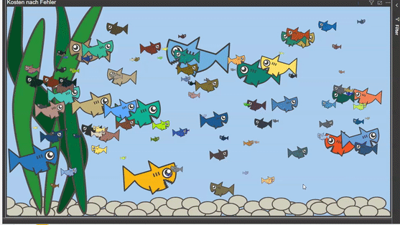
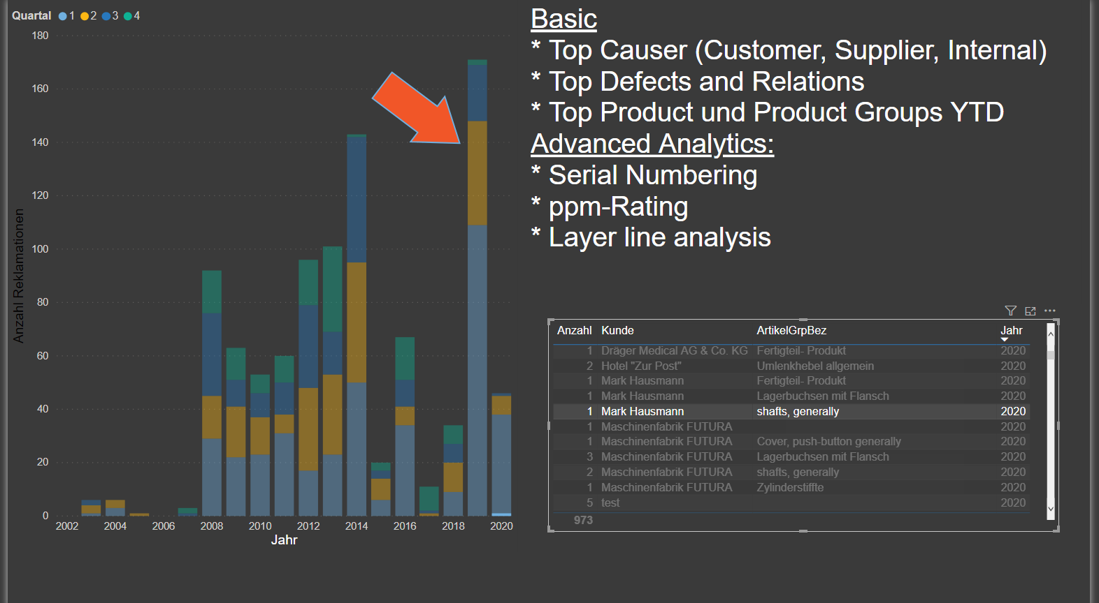
PDAP Management View CAQ BI and Analytics
Server based Enterprise Reporting Platform (based on SQL Server Reporting Services)
Business Intelligence - Data models for Power BI
Providing KPI’S and one-click on one-page overviews
work's inside a browser

Slide 10
PDAP System Management
User Management
Role Management
Attendant Modules
Gauge Maintenance
Reminder and To Do Lists
Q-Link – Hyperlink Service to invoke Modules by third party tools and websites

Slide 11
Overview Reference Customers with international dependances
ZF (Germany, Czech Republic, Ukraine)
Cherry (Germany)
GPE Group (Germany)
2E mechatronic GmbH & Co. KG
DOMETIC (Germany, Sweden)
EMS (Germany, China)
DUNGS (Germany, China, Denmark)
SCHWARTAUER WERKE (Germany)
PRETTL (Germany)
MOTORTECH (Poland)
…

Slide 12
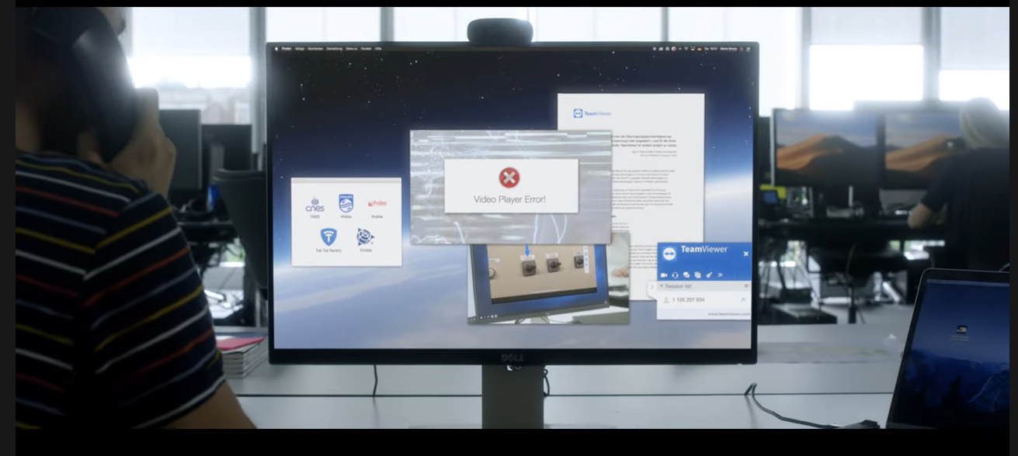
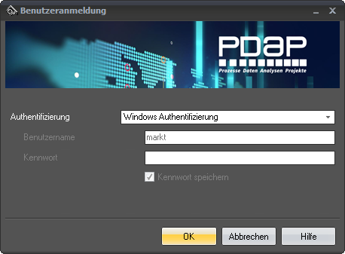
Support in German an English
Support in German an EnglishSupport - Daily on telephone and per remote supporting via TeamViewer included.
(Different Remote Solution regarding to customer needs possible applicable when needed)

Slide 13
PDAP Team
Mark Hausmann Solution Development - Insights & Data
Bodo Weber Head of Sales
Process
Data
Analytics
Projects
Hans jürgen Lenz CEO
Holger Leu Management
 | JessenLenz Computerentwicklungs- und Vertriebsgesellschaft mbH Steinmetzstrasse 3 D-23556 Lübeck - Germany Tel.: +49 451 – 87 360 0 allg. eMail: info@pdap.de Internet: www.pdap.de Tel. Vertrieb: 0451-87360-12
Horst Strohkirch System Specialist
Nils Caliebe Interface Specialist
PDAP Team using HONEYWELL climbing protection

